Slide 1



evolution with a STRESS-induced mutation rate
Yoav ram
Hadany lab – the Evolutionary theory lab
Department of Molecular biology and ecology of plants
Life sciences faculty
Tel-aviv University
February 10 2014

Slide 2



Variability in mutation rates
Between species
Rates are in average number of measurable mutations per genome per generation
Flies: 0.455
Keightley et al. Gen Res 2009
Humans: 41
Lynch, PNAS 2010
Bacteria: 0.0004
Wielgoss et al. G3 2011
2

Slide 3
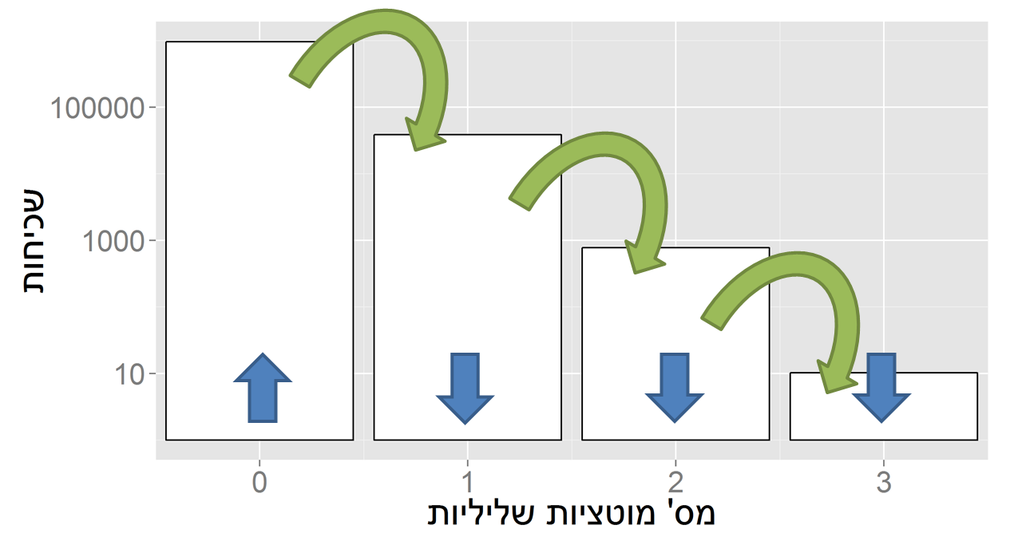
Evolution in a static environment
Directional selection without change
A balance between mutation and natural selection
Frequency
# Deleterious mutations

Slide 4
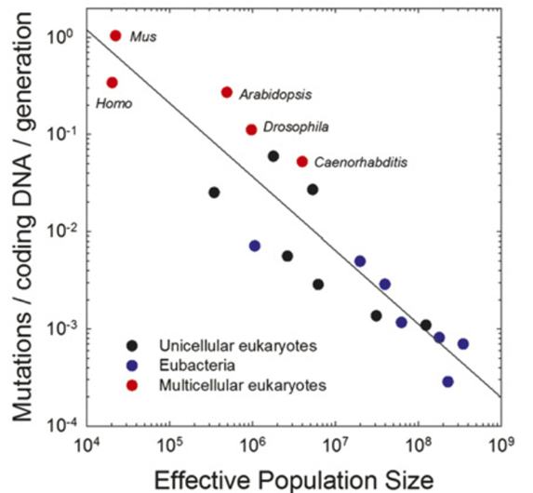

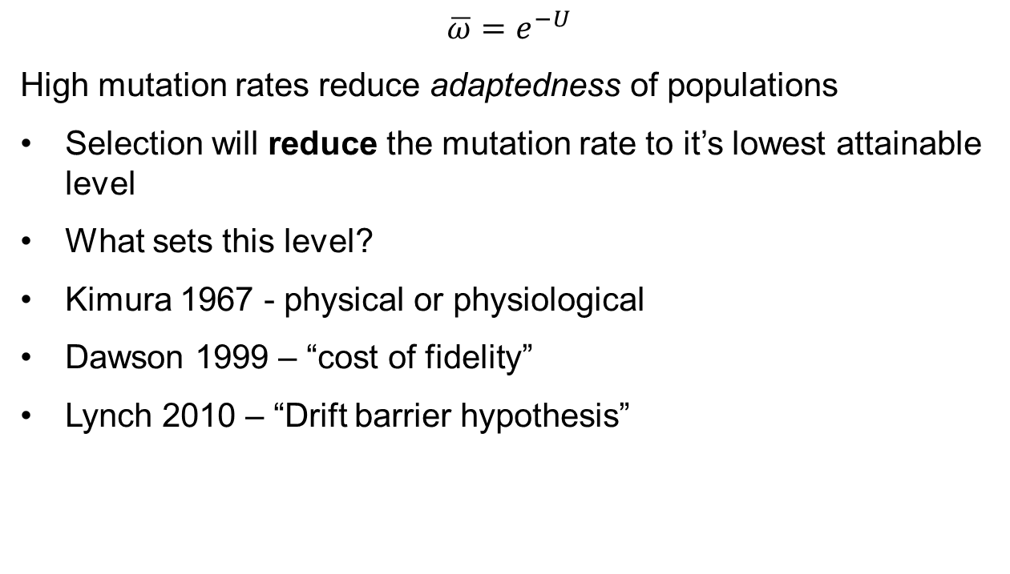
Mutation rate in static environments
$$\overline{ω}=e^{−U}$$
High mutation rates reduce adaptedness of populations
Selection will reduce the mutation rate to it’s lowest attainable level
What sets this level?
Kimura 1967 - physical or physiological
Dawson 1999 – “cost of fidelity”
Lynch 2010 – “Drift barrier hypothesis”
Sung et al. PNAS 2012

Slide 5
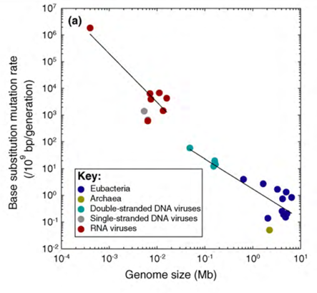
Non-adaptive hypotheses
Genome size (Mb)
Effective population size
Sung et al. PNAS 2012

Slide 6

Evolution in a dynamic environment
In changing environments rapid adaptation can be favored by natural selection (adaptability)
The mutation rate must balance between adaptability and adaptedness

Slide 7

Variability in mutation rates
Within species
Mutation rate in 69 natural populations of E. coli – Matic et al. 1997

Slide 8
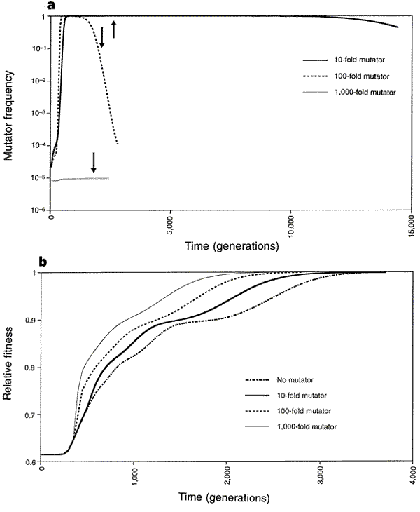
Adaptation with mutator alleles
x100
x10
x1
x1,000
Taddei, et al. Nature 1997

Slide 9
Rise and fall of the mutator allele
x10
x100
x1,000
Taddei, et al. Nature 1997
Notes:
An arrow symbolizes the time when population fitness has reached 0.99

Slide 10

Variability in mutation rates
Within individuals
DNA polymerase error rate – Lynch 2011

Slide 11

Stress-induced mutation
Rosenberg et al. 2012
In E. coli:
Error prone polymerase induced by stress responses:
SOS response
DNA damage
Starvation
Mismatch repair system
Other mechanisms:
Galhardo et al. 2007
Al Mamun, Science 2012

Slide 12

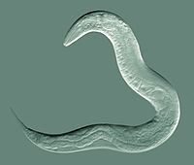
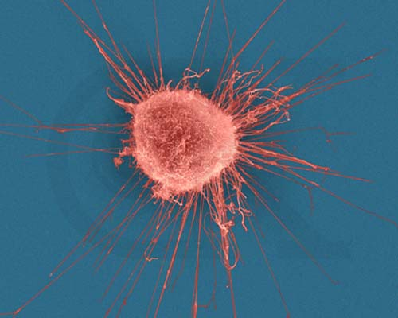



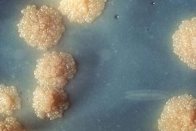

Evidence
Green algea
Nematodes
E. coli
Bacillus subtilis
Breast cancer cell
D. Melanogaster
M. tuberculosis
L. monocytogenes

Slide 13

Evolution of stress-induced mutation
Null hypothesis
Mutagenesis is the by-product of stress
Alternative non-adaptive hypotheses
Cost of fidelity
Drift barrier hypothesis
Adaptive hypothesis
Second order selection

Slide 14
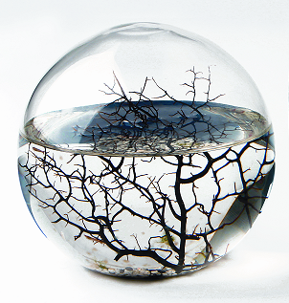
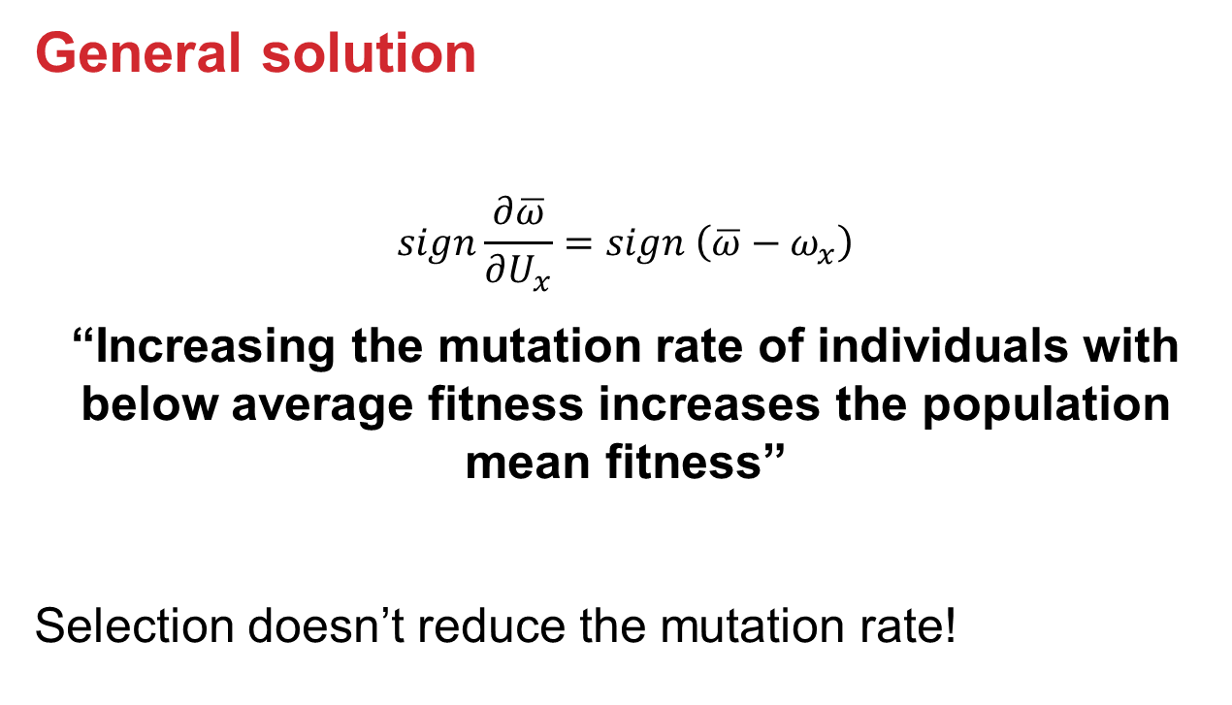
Static environment
General solution
$$sign\frac{∂\overline{ω}}{∂U_{x}}=sign \left(\overline{ω}−ω_{x}\right)$$
“Increasing the mutation rate of individuals with below average fitness increases the population mean fitness”
Selection doesn’t reduce the mutation rate!

Slide 15

Static environments
Constitutive mutator (CM)

Slide 16

Static environments
Stress-induced mutator (SIM)

Slide 17

Rapidly changing environments
The Red Queen hypothesis (van Valen, 1973):
“It takes all the running you can do, to keep in the same place.”
- Lewis Carrol, Through the Looking Glass
What happens when the environment changes frequently?

Slide 18
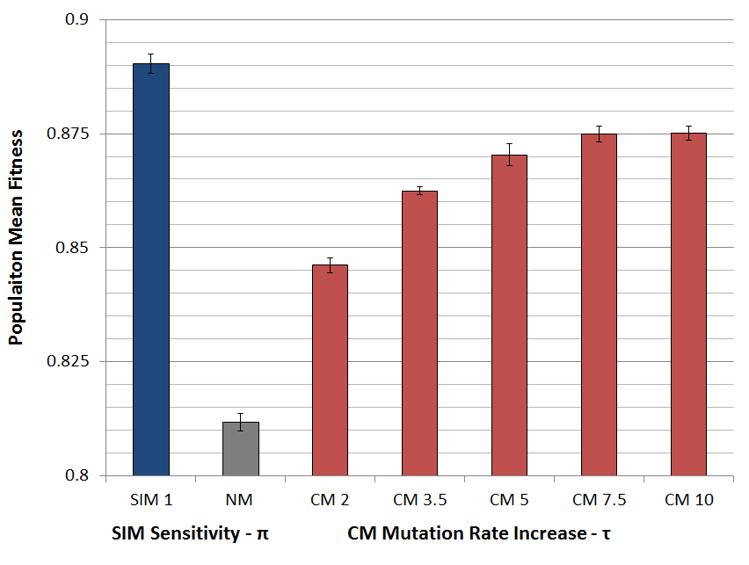
Populations with SIM are fitter

Slide 19

SIM wins competitions

Slide 20

SIM wins competitions

Slide 21
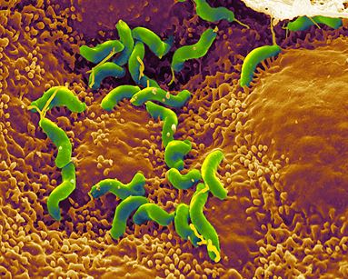
Summary: Evolution of stress-induced mutation
Stress-induced mutators evolve:
In finite & infinite populations
In constant & changing environments
Second-order selection can lead to the evolution of stress-induced mutagenesis in asexual populations
Selection for evolvability
H. pylori

Slide 22
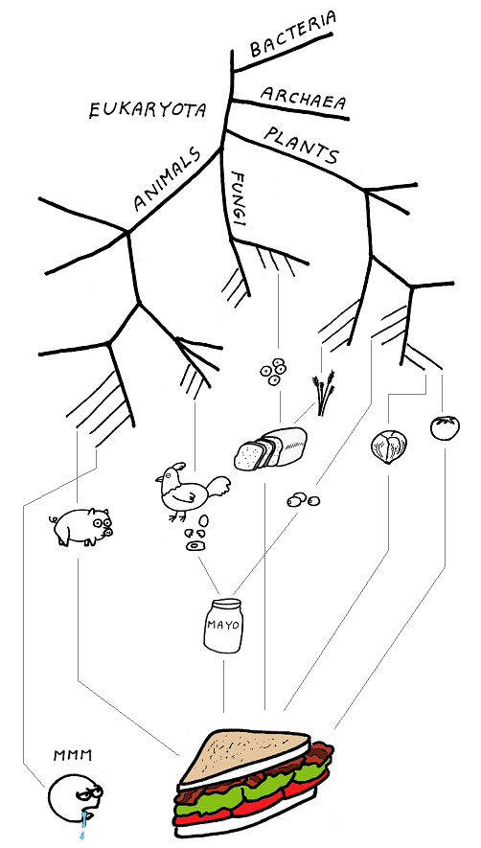
Consequences of stress-induced mutation rate
How does SIM affect evolution?

Slide 23
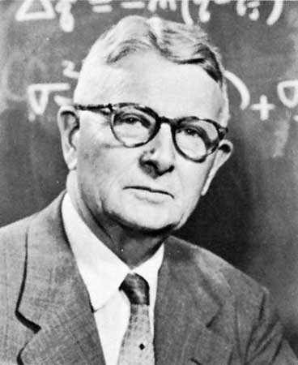
Adaptive peak shifts
This problem was introduces by Sewall Wright in 1931:
If a new adaptation requires several, separately deleterious mutations, how can it evolve?

Slide 24
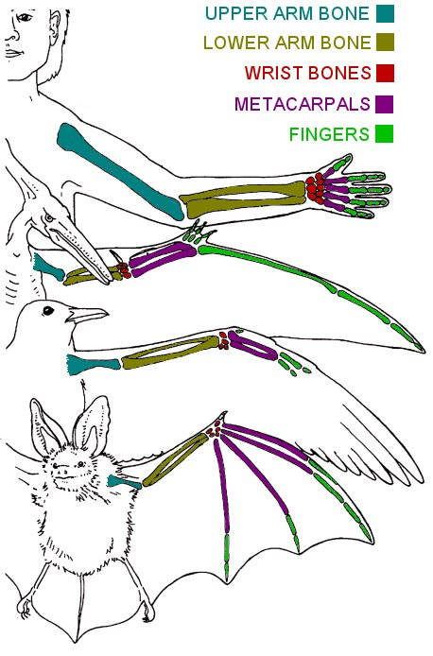
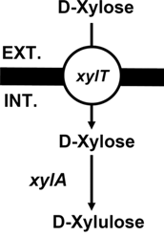
examples
Criteria
Adaptation requires a change in two or more traits
Change in only one trait causes reduced fitness
Wings and bones
Flying with heavy bones is costly
Walking and climbing with light bones is dangerous
New metabolic pathway
Two new proteins required – pump and enzyme
each is wasteful without the other
Adaptation to high UV (Haldane 1932, p. 175)
Dark skin – increased pigmentation
Vitamin D storage in the liver
Xiao et al. 2011

Slide 25
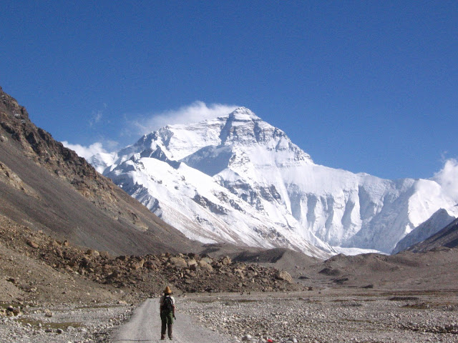
Simple landscape

Slide 26
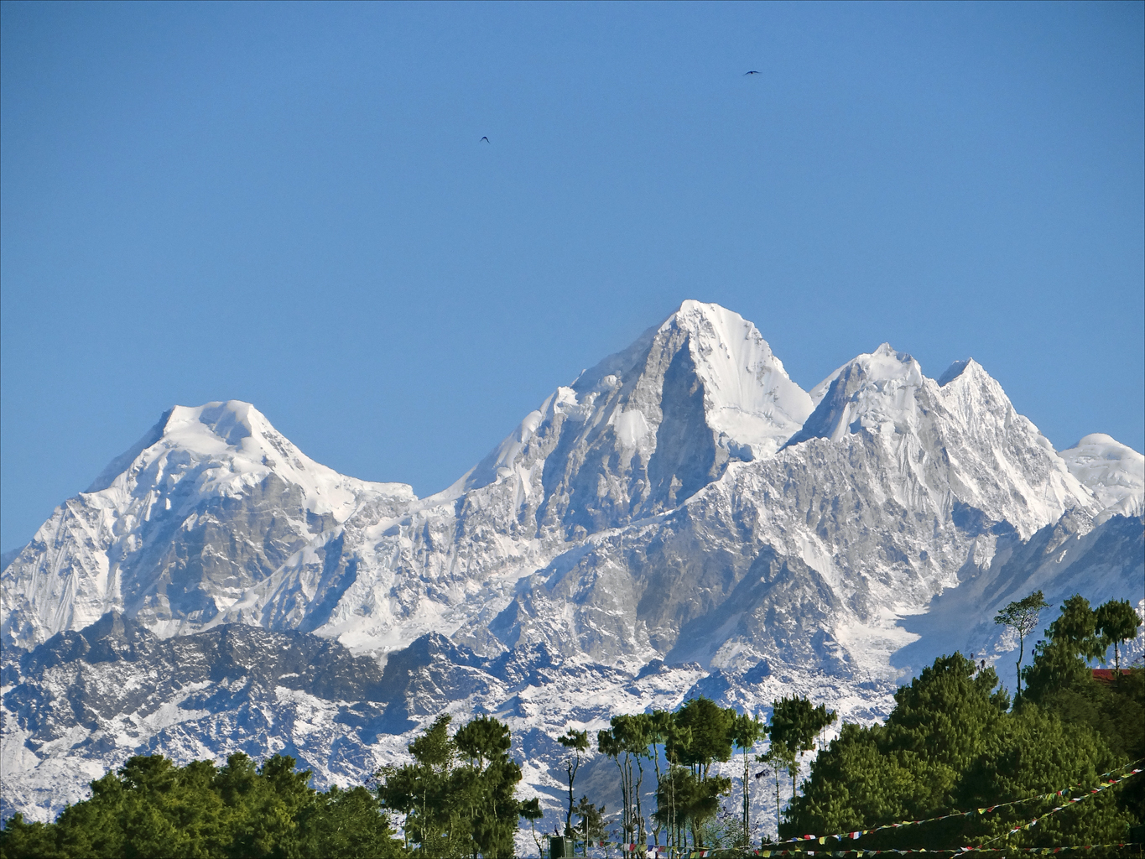
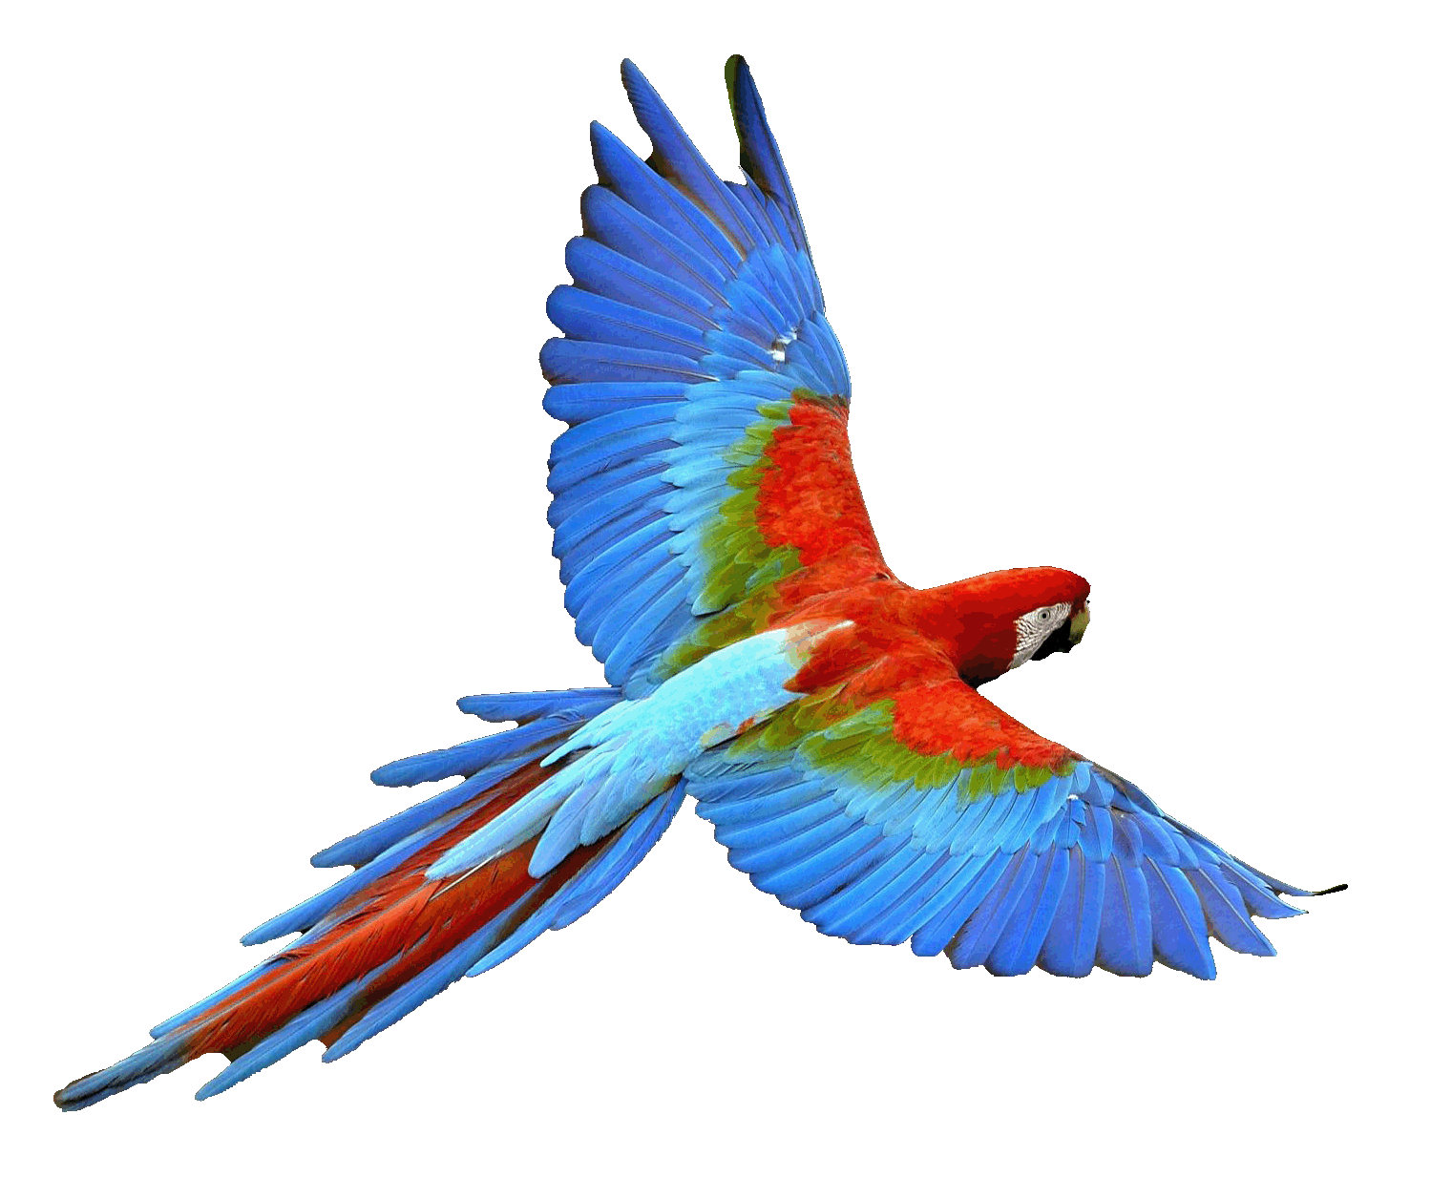
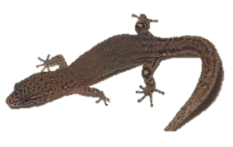
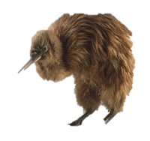
Rugged landscape
Wings
Light bones
No wings
Heavy bones
No wings
Light bones

Slide 27
Adaptive Peak shift
High peak
Low peak
Valley

Slide 28
SIM & rugged landscape
Increasing the mutation rate in individuals below both peaks
High mutation rate
Low mutation rate

Slide 29
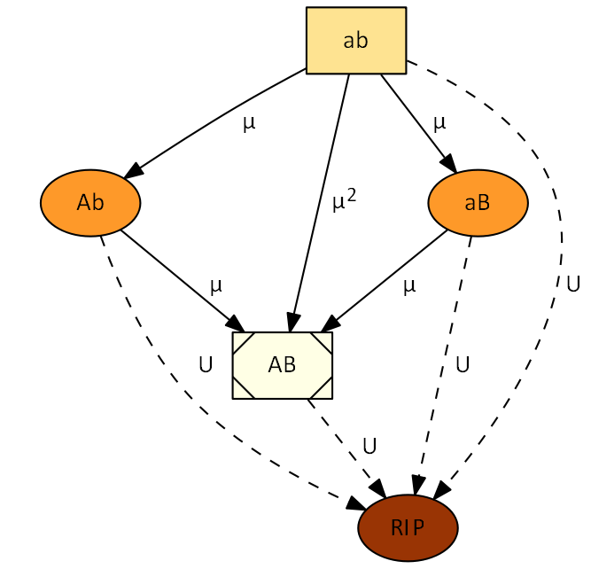
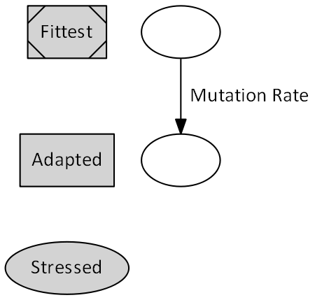


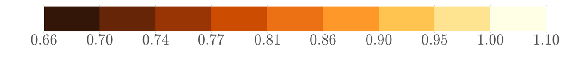
Deterministic model
fitness

Slide 30
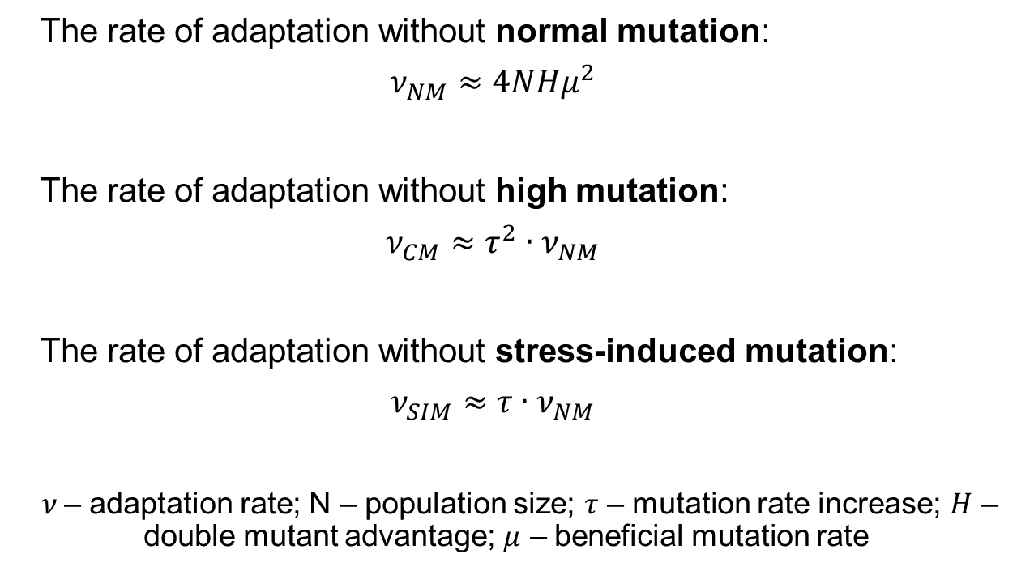
Deterministic results
The rate of adaptation without normal mutation:
$$ν_{NM}≈4NHμ^{2}$$
The rate of adaptation without high mutation:
$$ν_{CM}≈τ^{2}∙ν_{NM}$$
The rate of adaptation without stress-induced mutation:
$$ν_{SIM}≈τ∙ν_{NM}$$
$ν$– adaptation rate; N – population size; $τ$ – mutation rate increase; $H$ – double mutant advantage; $μ$ – beneficial mutation rate

Slide 31
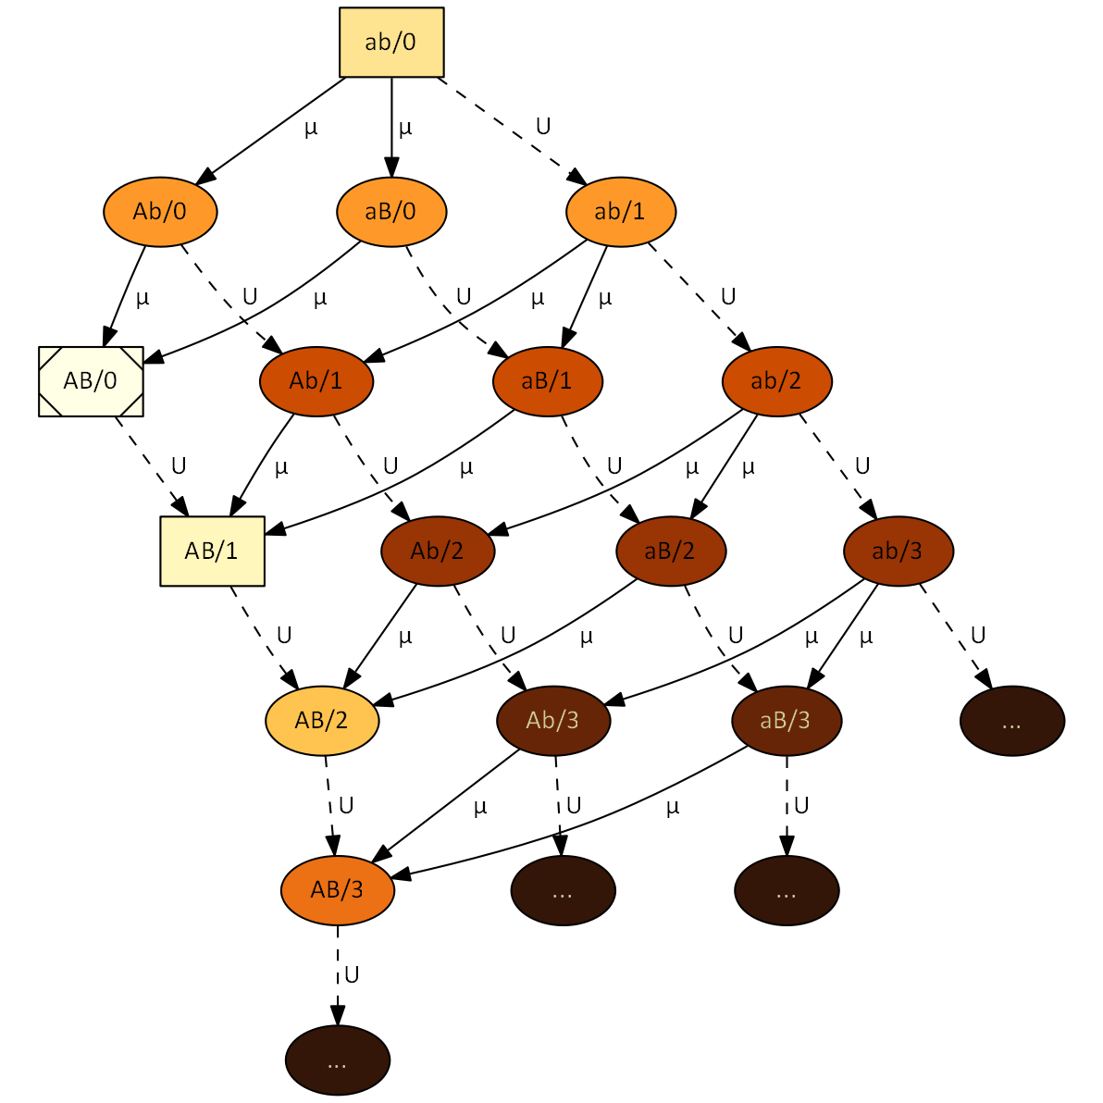


Stochastic model
No MSB assumption
No
fitness

Slide 32
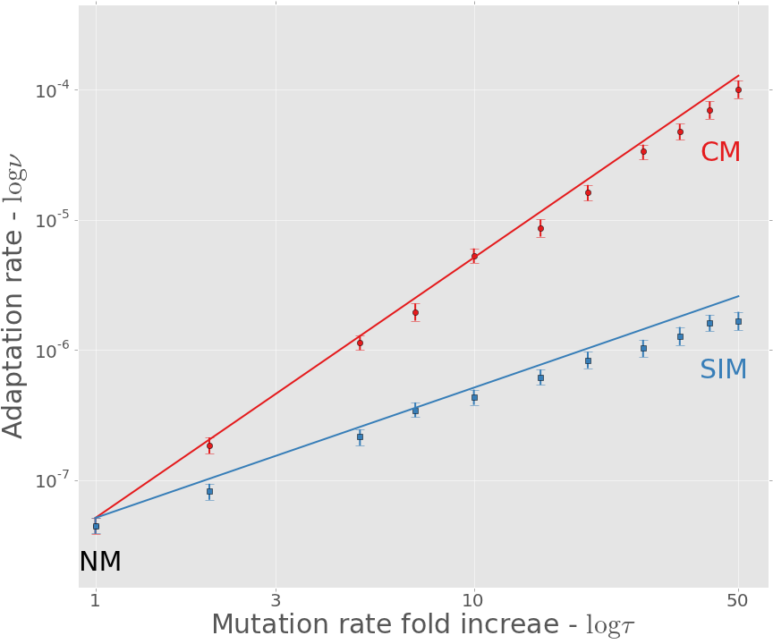
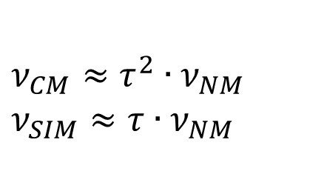
Adaptation rate
$$ν_{CM}≈τ^{2}∙ν_{NM}$$
$$ν_{SIM}≈τ∙ν_{NM}$$
Approximation
Simulation

Slide 33
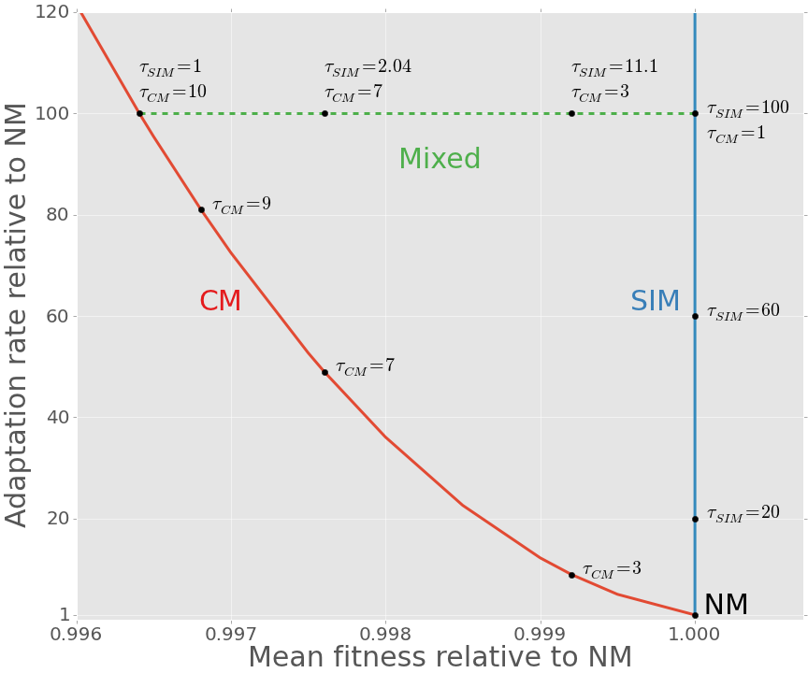
SIM Breaks the adaptability-adaptedness trade-off
Adaptability - Adaptation rate relative to NM
Adaptedness - Mean fitness relative to NM (non-mutator)

Slide 34



Conclusion
Evolution of Stress-induced mutagenesis:
SIM can evolve due to second order selection
In constant and changing environments
Effects of stress-induced mutagenesis:
SIM increases the adaptation rate without reducing the population mean fitness
Breaks the trade-off between adaptability and adaptedness
yoavram@post.tau.ac.il
@yoavram
http://www.yoavram.com

